Slide 1
Users Really Do Plug in USB Drives They Find
Matthew Tischer, et al , University of Illinois
Urbana Champaign
Presented By : Akhilesh Bhati

Slide 2
Background
Security Community belief:
Peoples can be engineered
Connect lost USBs to computers
MS Windows – No longer auto-execute USB code
USBs can be exploited to auto boot the computer
USB Drive Engineering :
Similar study 11/30 drives opened
CompTIA study with 200 drives
Social Engineering – Mobile
Decision Making – DOSPERT Scale, SeBIS
Video
Http
DoSpeRT : Domain Specific Risk Taking ; 5 Domains
SeBIS : Security Behaviour Intentions Scale;
Notes:
1. Security community belief that users can be socially engineered into picking up and plugging in seemingly lost USB flash drives they find.
2. Microsoft Windows no longer automatically executes arbitrary code when connecting a USB drive (Video)
3. Social networks to increase the effectiveness of phishing attacks 50 unsecured smartphones in cities to observe their finders’ behaviors
DOSPERT is a psychometric scale, FOR DIFFERENT CULTURES that assesses risk taking in five content domains: financial decisions (separately for investing versus gambling), health/safety, recreational, ethical, and social decisions
There were 40 items (in year 2002) on scale now reduced to 30 items ON SCALE.
SeBIS : Security knowledge and behavior

Slide 3
Survey : Objective
Three “W”s
Whether people connect to computers when they find USB drives?
Whether can we increase the effectiveness of USB related attack?
Why the people connected USBs & files/content interested while exploring USBs?

Slide 4
Survey Methodology: Experiment
Dropped 297 drives on the University of Illinois campus.
30 different locations
5 types of drives
3 days ( Day1=143, Day2 = 145 Day3 = 9)
2 times of day (Morning and Afternoon).
Recorded the time when people connected the USB drive.
Presented people to participate in the online Survey.
Notes:
Target 300 Drives
1 – Lost
2 - Location was not identified
Online Survey through SurveyMonkey with 10$ cash or Amazon Card for “finding their risk attitudes”

Slide 5
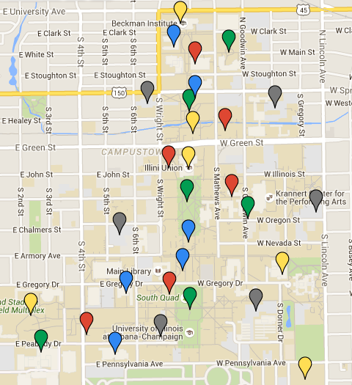
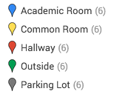
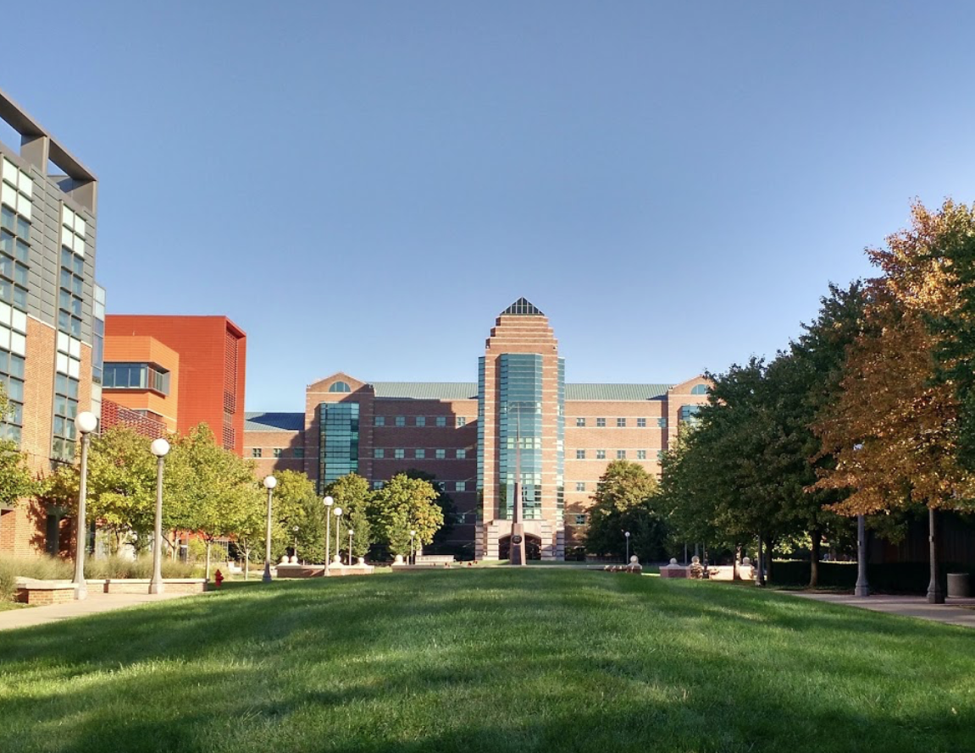
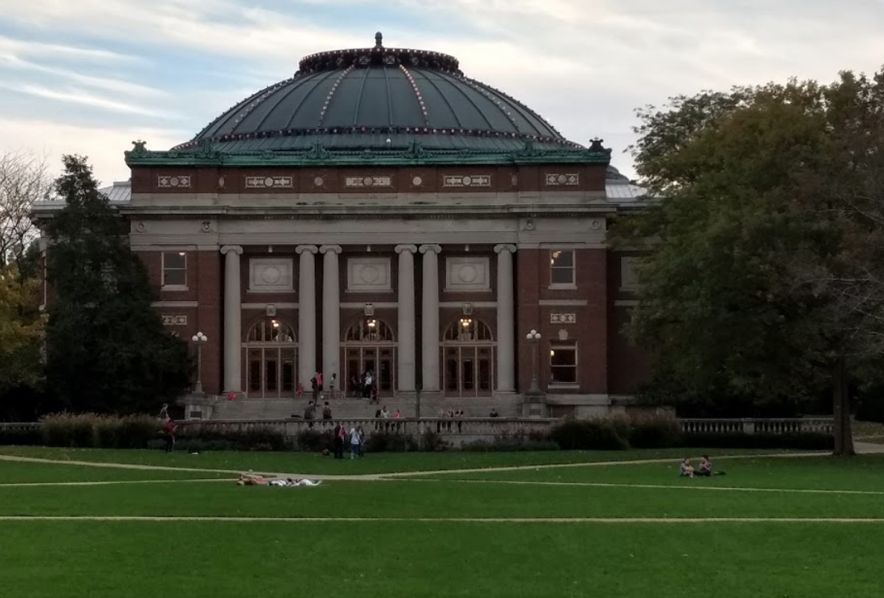
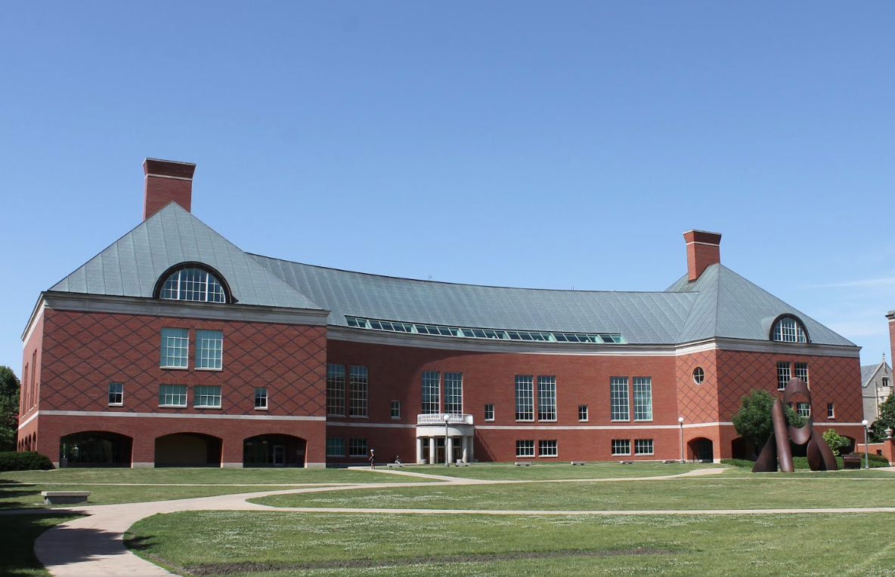
Survey : Methodology
58
60
59
60
60
Notes:
1. Engineering Quad
2. Main Quad
3. South Quad

Slide 6
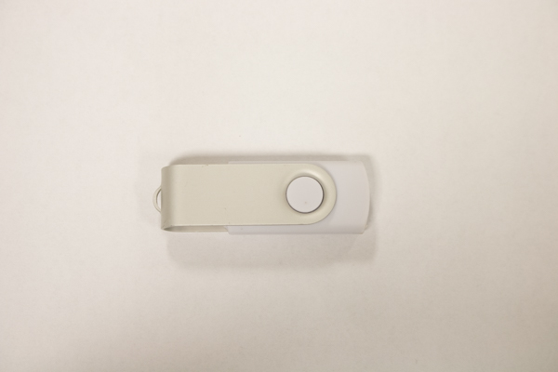
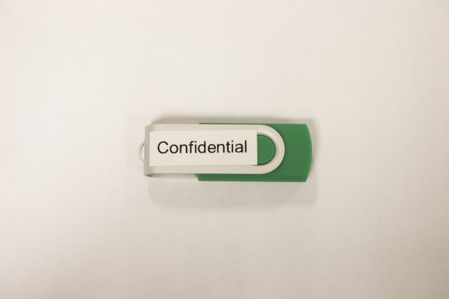
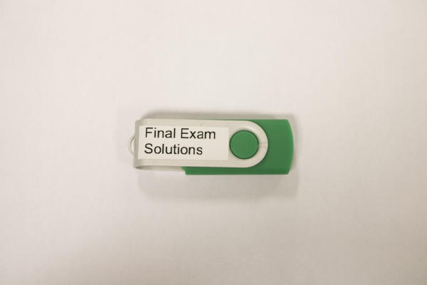
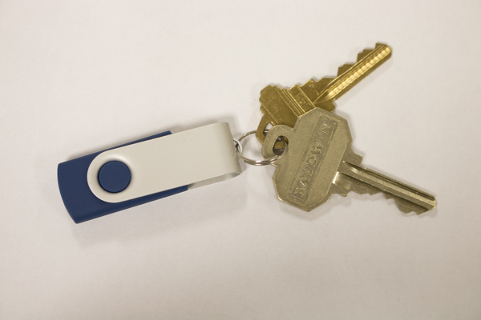
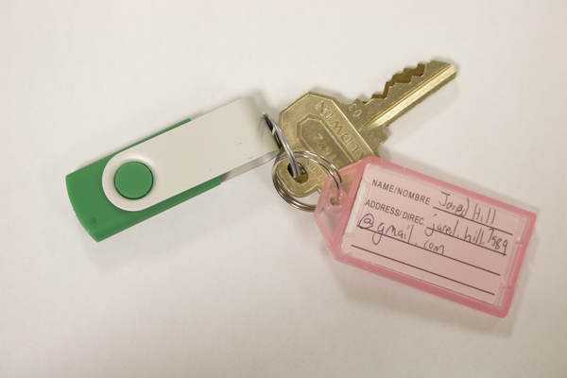
Survey Methodology : USB Drive appearance
Akhilesh Bhati
ID # 201605474
Qatar University

Slide 7
Survey Methodology : USB Drive Content
Personal Contents
Unlabeled
Keys
Return label
(b) Business Contents
(c) Exam Contents
Personal Content
Business Contents
Exam Contents
Notes:
User-Agent String

Slide 8
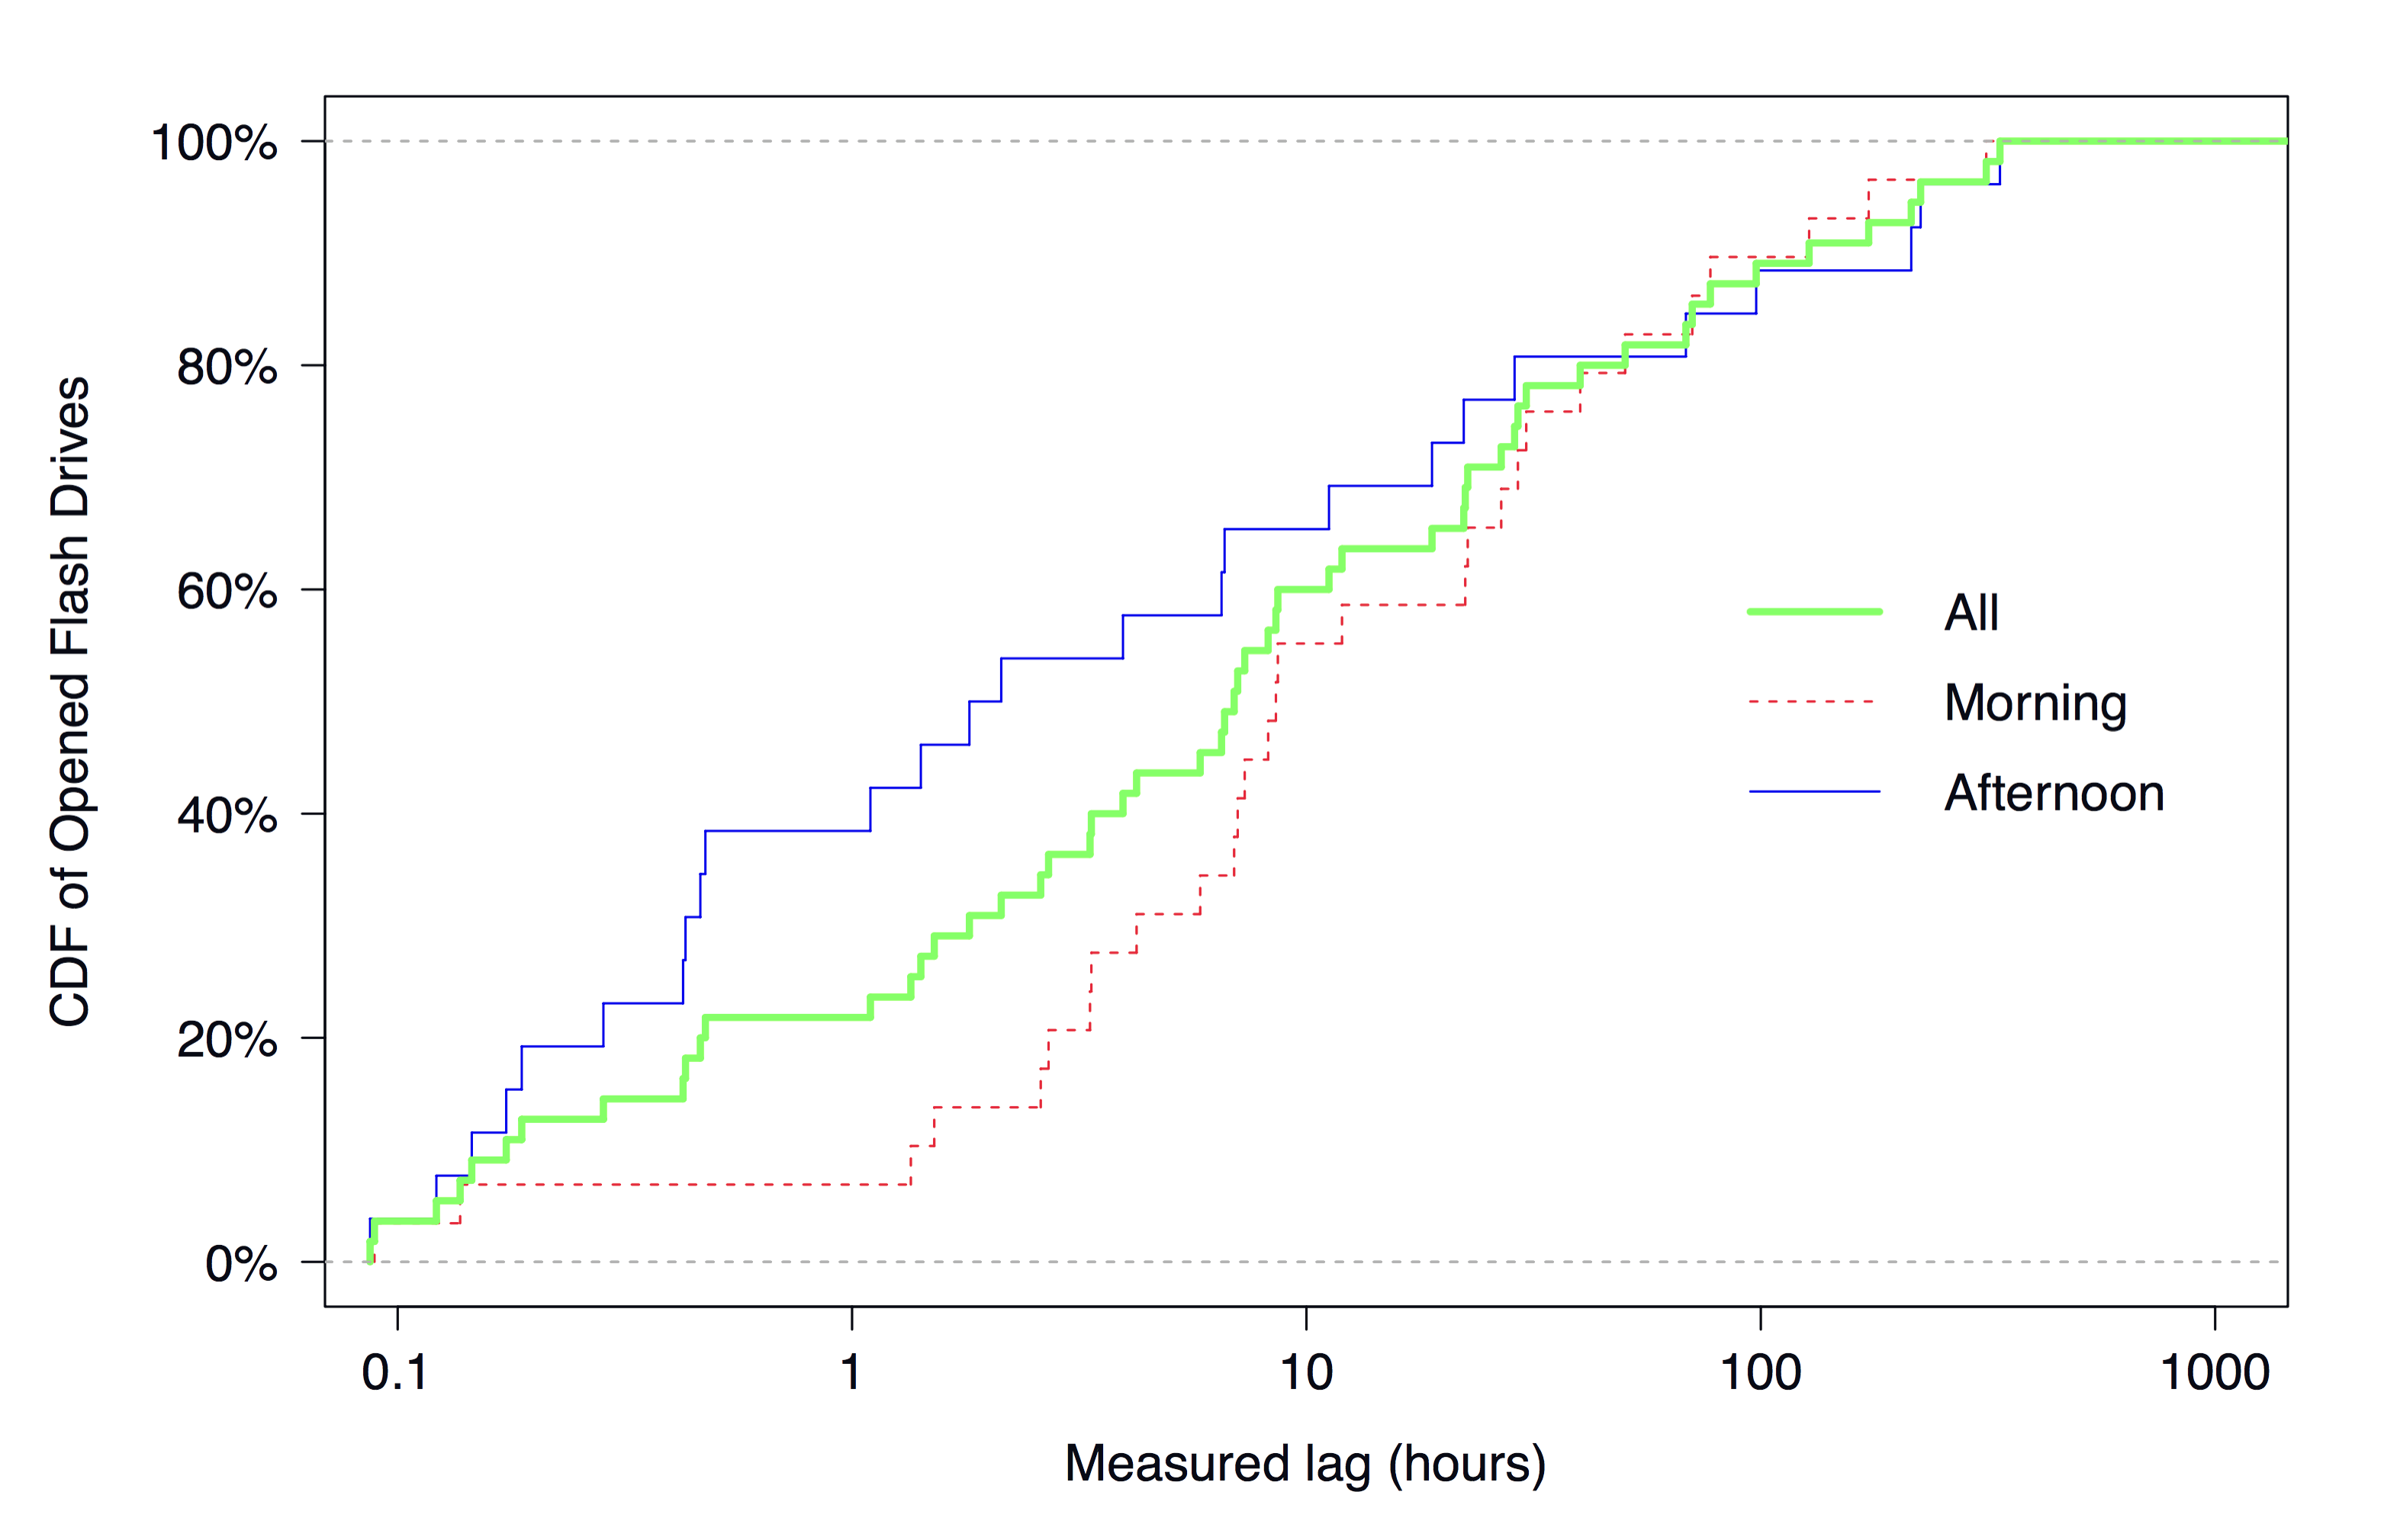
Survey : Results
All 135 connected
Median 6.9 Hours
Average 38.5 Hours
First USB drive connected
Notes:
1. CDF = Cumulative Distributive Function (with one variable)
2. 73 out of 135 did not opt to provide the data) Online survey

Slide 9
Survey : Results

Slide 10
Survey : Results
File Name Frequency |  | Frequency
Confidential |  | 13/58 | 22%
 | 2015_proj1/feb12proposalA.pptx | 4/13 | 31%
 | 2015_proj1/patent_app_0217.pdf | 3/13 | 23%
 | employee/termination_notice_*.pdf | 3/13 | 23%
 | strategy/plan_for_2015_2016.pptx | 2/13 | 15%
 | strategy/0425_meeting_notes.pdf | 1/13 | 8%
Exams |  | 12/58 | 21%
 | sp15/examA.pdf | 6/12 | 50%
 | fa10/examA.pdf | 3/12 | 25%
 | fa10/solutionsA.pdf | 1/12 | 8%
 | fa13/examB.pdf | 1/12 | 8%
 | sp10/examA.pdf | 1/12 | 8%
Keys |  | 11/58 | 19%
 | Pictures/Winter Break/*.jpg | 5/11 | 45%
 | Documents/resume.pdf | 4/11 | 36%
 | Documents/reflective_essay_02.docx | 2/11 | 18%
Return Label |  | 7/58 | 12%
 | Pictures/Winter Break/*.jpg | 3/7 | 43%
 | Documents/resume.pdf | 2/7 | 29%
 | Math Notes/2-13.docx | 1/7 | 14%
 | No files recorded | 1/7 | 14%
None |  | 15/58 | 26%
 | Documents/resume.pdf | 8/15 | 53%
 | Pictures/Winter Break/*.jpg | 5/15 | 33%
 | Math Notes/2-13.docx | 1/15 | 7%
 | No file | 1/15 | 7%
77 people does not opt to participate. Excluded from survey.
58 people participate & opened files.
Result:
Altruistic Motivation
Self Interest
Notes:
Each file is an HTML with an embedded image that allows us to track when users open file.

Slide 11
Survey : Results
Notes:
Motivation : Why did you pick up the drive and connected to system
Answer : The respondents answered that they wanted to return the drive (68%) and expressed curiosity (18%)
Precautions taken while connecting the USB Drive:
(a) Users underestimate the risk of visiting malicious websites considering .html extension
(b) Users intentionally use institutional resources. One of the response was ”I sacrificed a university computer.”
© Users trust their OS and security software to protect them,
(d) A few users took reasonable precautions, including opening the HTML file in a text editor and connecting the drive to an offline computer

Slide 12
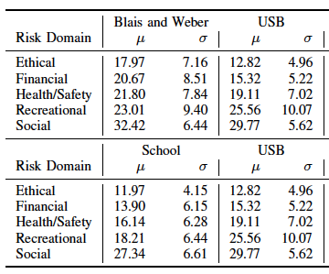
Survey: DOSPERT & SeBIS Results
DOSPERT- Result (62 Responses)
Recreational & Social Risk
Recreational = Curiosity
Social = Self Interest.
SeBIS – Result (62 Responses)
College / University Students have different security knowledge than general population.
DoSpeRT : Domain Specific Risk Taking ; 5 Domains
SeBIS : Security Behaviour Intentions Scale;
Notes:
We believe that participants’ risk-averseness compared to the general population and typically-equivalent security knowledge compared to their peers suggests that the attack would be effective against most users.
SeBIS : Conducted based on 15 questions selected from Eagleman and Peer.

Slide 13
Survey: Objectives Results
Three “W”s
Whether people connect to computers when they find USB drives?
Answer : Yes - 45 to 98% success rate
Whether can we increase the effectiveness of USB related attack?
Answer : 1. No. (each of 5 types, time, place – No effect)
2 . BUT it can be decreased if labeled.

Slide 14
Survey: Objectives Results
Three “W”s
Why they connected USBs & files/content participants interested while exploring USBs.
Answer : 1. Curiosity
2. Self Interest
3. Compromised University computer (concern)
4. 68% Participants take no precautions
5. 68% Participants want to return the drive.

Slide 15
Conclusion
USB attack is successful with 45-98% success rate
Curiosity and Motivation are the main reasons for pick up the drives.
Change in the appearance, time, place, gender, affiliation have no effect.
Participants pick-up USB for return purpose.
Attack effects can be reduced if USBs are labled

Slide 16
Thanks

